Slide 1
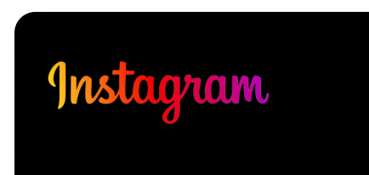
Project Description
User analysis involves tracking how users engage with a digital product, such as a software application or a mobile app.
User analysis involves tracking how users engage with a digital product, such as a software application or a mobile app.
Notes:
Project Description:
Provide a brief overview of the project, explaining its purpose and the approach you will take to handle the tasks and derive insights.

Slide 2
Approach
Firstly we imported data to MySQL workbench
Then we did study of our data ,Knowing which table contains what information their data types, how tables are connected that is schema of tables
Then to answer board members we chose tables for analysis as Users, Photo, Likes, Tags, Photo_tags.
Then we did analysis on above tables.
Notes:
Approach:
Describe your approach towards the project and how you executed it. Explain the steps you took to analyze the data and find the answers to the questions.

Slide 3

Tech-Stack Used
MySQL Workbench
SQL Server Management Studio
Notes:
Tech-Stack Used:
Specify the software and versions you used for the project (e.g., MySQL Workbench, SQL Server Management Studio) and briefly explain why you chose them for the project.

Slide 4
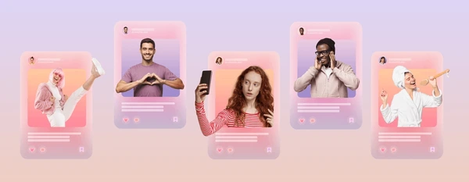


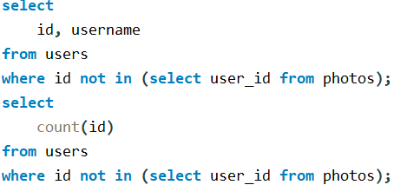
Insights
Marketing Analysis
1.Loyal User Reward: five oldest users on Instagram
Darby_Herzog Emilio_Bernier52 Elenor88 Nicole71 Jordyn.Jacobson2
2. Inactive Users: users who have never posted a single photo
Aniya_Hackett | Ollie_Ledner37 | Mike.Auer39 | Esther.Zulauf61
Kasandra_Homenick | Mckenna17 | Franco_Keebler64 | Bartholome.Bernhard
Jaclyn81 | David.Osinski47 | Nia_Haag | Jessyca_West
Rocio33 | Morgan.Kassulke | Hulda.Macejkovic | Esmeralda.Mraz57
Maxwell.Halvorson | Linnea59 | Leslie67 | Bethany20
Tierra.Trantow | Duane60 | Janelle.Nikolaus81
Pearl7 | Julien_Schmidt | Darby_Herzog
Notes:
Insights:
Summarize the insights and knowledge you gained while working on the project. Explain the inferences you made from the data, highlighting any significant findings or patterns. Keep the insights concise and relevant to the project.
Loyal User Reward:
The marketing team wants to reward the most loyal users, i.e., those who have been using the platform for the longest time. Your Task: Identify the five oldest users on Instagram from the provided database.
SQL Query –
*/
select
Id, username, rank() over(order by created_at) as rankingfrom users limit 5;/*
2.Inactive User Engagement:
The team wants to encourage inactive users to start posting by sending them promotional emails. Your Task: Identify users who have never posted a single photo on Instagram.

Slide 5
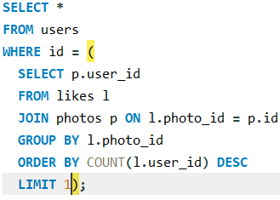


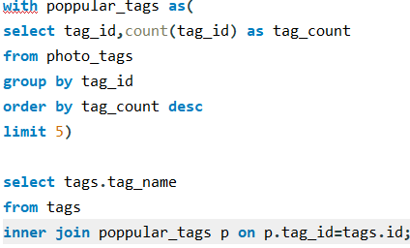
Insights
Marketing Analysis
3. Contest Winner Declaration
User Name – Zack_Kemmer93
User Id – 52
Account created date- 2017-01-01 05:58:22
4.Hashtag Research
Smile
Beach
Party
Fun
Concert
Notes:
3.Contest Winner Declaration:
The team has organized a contest where the user with the most likes on a single photo wins. Your Task: Determine the winner of the contest and provide their details to the team.
4. Hashtag Research:
A partner brand wants to know the most popular hashtags to use in their posts to reach the most people. Your Task: Identify and suggest the top five most commonly used hashtags on the platform

Slide 6

Insights
Marketing Analysis
5.Ad Campaign Launch Day:
Notes:
5.Ad Campaign Launch:
The team wants to know the best day of the week to launch ads. Your Task: Determine the day of the week when most users register on Instagram. Provide insights on when to schedule an ad campaign.

Slide 7
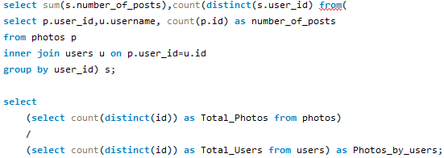
Insights
Investor Metrics
1.User Engagement.
Total photos
256
Total users
100
Average photos/user
2.56
Notes:
B) Investor Metrics:
User Engagement:
Investors want to know if users are still active and posting on Instagram or if they are making fewer posts. Your Task: Calculate the average number of posts per user on Instagram. Also, provide the total number of photos on Instagram divided by the total number of users.
2.Bots & Fake Accounts:
Investors want to know if the platform is crowded with fake and dummy accounts. Your Task: Identify users (potential bots) who have liked every single photo on the site, as this is not typically possible for a normal user.

Slide 8
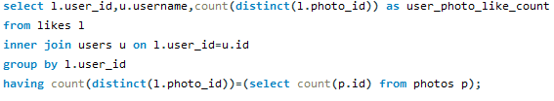
Insights
Investor Metrics
2.Bots & Fake Accounts:
Aniya_Hackett | Julien_Schmidt
Jaclyn81 | Mike.Auer39
Rocio33 | Nia_Haag
Maxwell.Halvorson | Leslie67
Ollie_Ledner37 | Janelle.Nikolaus81
Mckenna17 | Bethany20
Duane60
Notes:
2.Bots & Fake Accounts:
Investors want to know if the platform is crowded with fake and dummy accounts. Your Task: Identify users (potential bots) who have liked every single photo on the site, as this is not typically possible for a normal user.

Slide 9
Achievements
For giving loyal users reward we found oldest 5 users.
To get inactive users we looked for users with zero posts. Inactive users count = 26
We got the winner of contest by finding most liked picture. Winner - Zack_Kemmer93
We suggested top 5 hashtags to a partner brand to help them reach more peoples.
To determining the day to launch the ad campaign for team we analysed the day when most accounts were created. Best days – Thursday & Sunday
For investors we did research for user engagement by finding average photos per user = 2.56
Also, we looked for potential bots and fake accounts by viewing which user has liked each post. Potential bots and fake accounts count-13
Notes:
Result
State the achievements you accomplished through the project and how it has benefited you or provided valuable information. Share your thoughts on the impact of the analysis and the insights derived from it.

